Slide 1

HealthLink A Healthcare Management System Your Health Intelligence, Our Focus
MS – Information Systems
Batch 2021-2023
Course – Application Engineering and Development

Slide 2

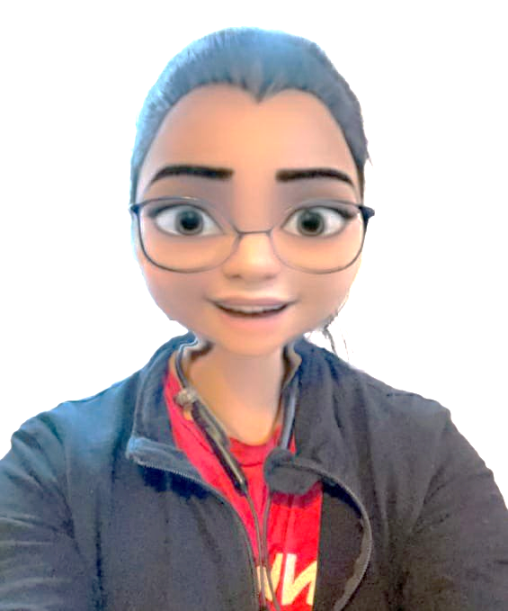

Team Goal Diggers
Nikita Gaurihar
Shesh Narayan Gupta
Bharat Tankala
NUID - 002980962
NUID - 001591912
NUID - 002192862

Slide 3
Table of Contents
About the Ecosystem
Problem Statement
Project Idea
UML Diagram
Application Flowchart
Application User Interface
Advanced Features
Data Visualization

Slide 4
About the Ecosystem
With the advent of technology and internet, many entrepreneurs from Small and Medium Enterprises are taking a step forward and rooting to move to virtual presence.
One of the best application of these technologies can be seen in Healthcare Industry. They have shaped Healthcare Management system to a next level.
Thus, this project aims to produce a robust real-time application that helps to bring patients, doctors, insurance agents, government and pharmacists together under one umbrella.
We have designed and developed an ecosystem which follows its operations inter-cities as well as inter-state. This application can be easily scaled up globally.

Slide 5
Problem Statement
During Covid 19 Pandemic, hospitals and doctors encountered the most challenging experiences and inevitable issues like anticipation of number of patients, lack of resources, efficient tracking and accessibility to medical provisions.
In order to restrain from repeating the same mistake, be it Covid 19 or any other medical issue, the provision of medical services should be the top priority.

Slide 6
Problem Statement…….
Thus, this project aims to produce a robust real-time application that helps to bring patients, doctors, insurance agents and pharmacists together under one umbrella.
We have designed and developed an ecosystem which follows its operations inter-cities as well as inter-state. This application can be easily scaled up globally.
This application demonstrates the reliability, sturdiness and robustness of our ecosystem.

Slide 7
Project Idea
We have designed and developed a healthcare management system, an ecosystem that can be extended to operate globally.
Our ecosystem consists of a network with 4 major Enterprises, 11 Organizations and 13 roles to carry out their respective functionality.
The network can be identified with the help of Zip codes.
Apart from this, we have also added advanced functionalities like Google map accessibility, Live web-cam image capture, etc. as the unique selling points of our project idea .

Slide 8
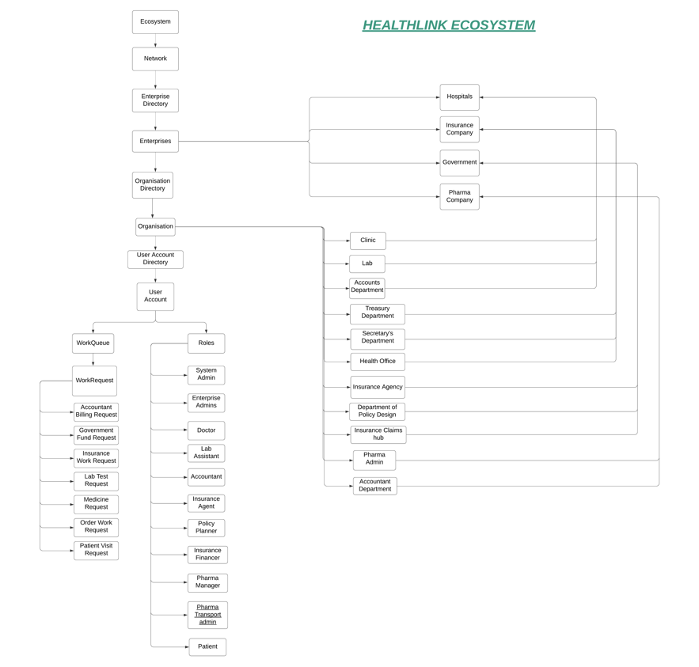
UML Diagram

Slide 9
Flowchart
Ecosystem
ENetwork
SERVICES
RETAIL
ESSENTIALS
EATERIES
CLEANING
DELIVERY
DELIVERY
DELIVERY
MECHANIC
VENDORS
SUPPLIERS
WHOLESALE
ELECTRICIAN
TRANSPORT
TRANSPORT
TRANSPORT
PLUMBING
FACTORIES

Slide 10
Flowchart
Ecosystem
ENetwork
SERVICES
RETAIL
ESSENTIALS
EATERIES
CLEANING
DELIVERY
DELIVERY
DELIVERY
MECHANIC
VENDORS
SUPPLIERS
WHOLESALE
ELECTRICIAN
TRANSPORT
TRANSPORT
TRANSPORT
PLUMBING
FACTORIES

Slide 11
Flowchart
Ecosystem
ENetwork
Hospitals
Insurance
Government
Pharmacy
CLEANING
DELIVERY
DELIVERY
DELIVERY
MECHANIC
VENDORS
SUPPLIERS
WHOLESALE
ELECTRICIAN
TRANSPORT
TRANSPORT
TRANSPORT
PLUMBING
FACTORIES

Slide 12
Flowchart
Ecosystem
ENetwork
Hospital
Insurance
Government
Pharmacy
CLEANING
DELIVERY
DELIVERY
DELIVERY
MECHANIC
VENDORS
SUPPLIERS
WHOLESALE
ELECTRICIAN
TRANSPORT
TRANSPORT
TRANSPORT
PLUMBING
FACTORIES

Slide 13
Flowchart
Ecosystem
Patient
ENetwork
Enterprise Admin
Hospital
Insurance
Government
Pharmacy
Manager
Transport
CLEANING
DELIVERY
DELIVERY
MECHANIC
VENDORS
SUPPLIERS
ELECTRICIAN
TRANSPORT
TRANSPORT
PLUMBING
FACTORIES

Slide 14
Flowchart
Ecosystem
Patient
ENetwork
Enterprise Admin
Hospital
Insurance
Government
Pharmacy
Treasurer
Manager
Secretary
Transport
Health Care Auditor
CLEANING
DELIVERY
DELIVERY
MECHANIC
VENDORS
SUPPLIERS
ELECTRICIAN
TRANSPORT
TRANSPORT
PLUMBING
FACTORIES

Slide 15
Flowchart
Ecosystem
Patient
ENetwork
Enterprise Admin
Hospital
Insurance
Government
Pharmacy
Agent
Treasurer
Manager
Policy Planner
Secretary
Transport
Claim/Finance
Health Care Auditor
CLEANING
DELIVERY
DELIVERY
MECHANIC
VENDORS
SUPPLIERS
ELECTRICIAN
TRANSPORT
TRANSPORT
PLUMBING
FACTORIES

Slide 16
Flowchart
Ecosystem
Patient
Network
Enterprise Admin
Hospital
Insurance
Government
Pharmacy
Docter
Agent
Treasurer
Manager
Lab Assistant
Policy Planner
Secretary
Transport
Accountant
Claim/Finance
Health Care Auditor
CLEANING
DELIVERY
DELIVERY
MECHANIC
VENDORS
SUPPLIERS
ELECTRICIAN
TRANSPORT
TRANSPORT
PLUMBING
FACTORIES

Slide 17
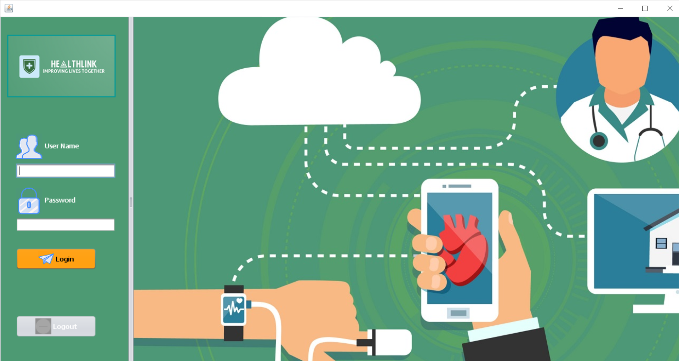
Application User Interface – Login Page

Slide 18
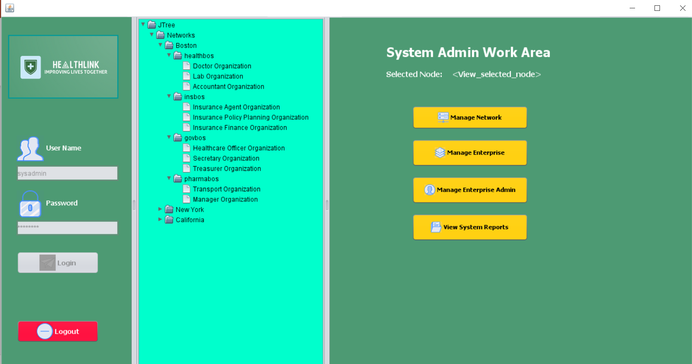
Application User Interface – Sysadmin Login Page

Slide 19
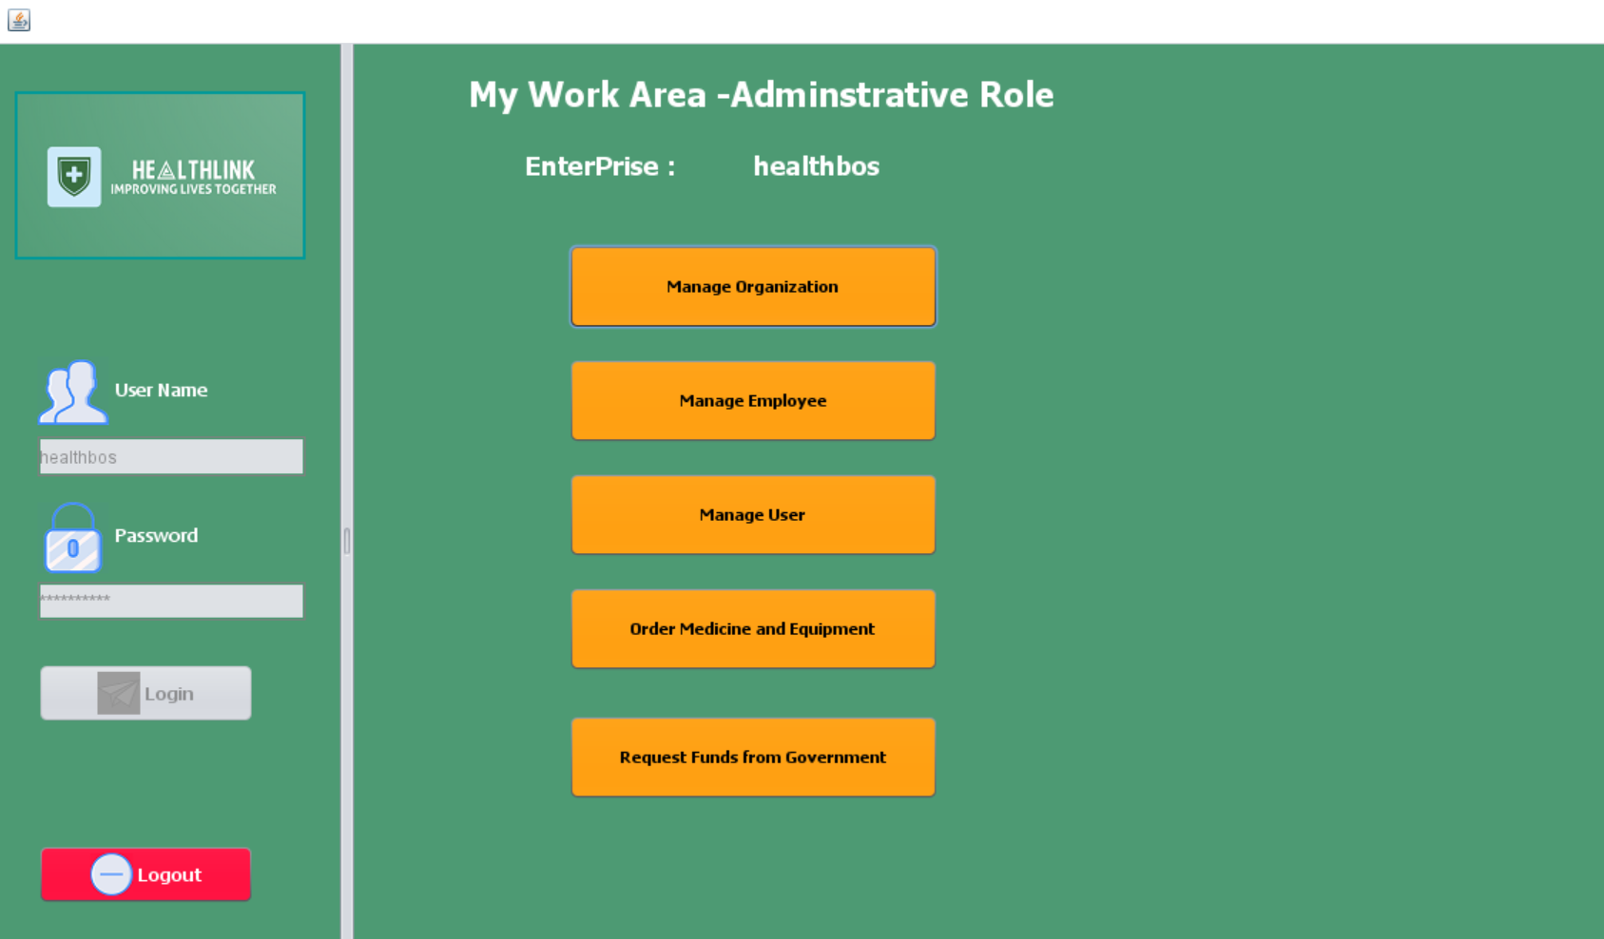
Application User Interface – Hospital Admin Login Page

Slide 20
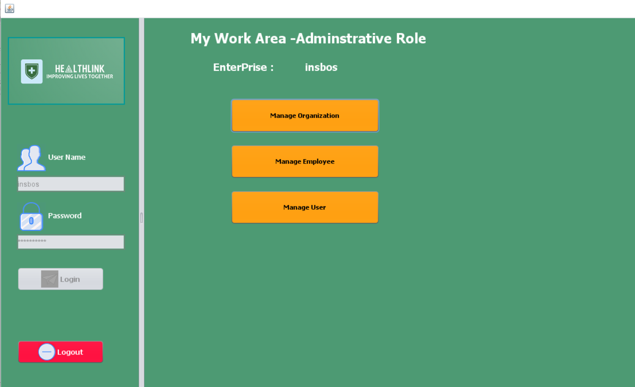
Application User Interface – Insurance Admin Login Page

Slide 21
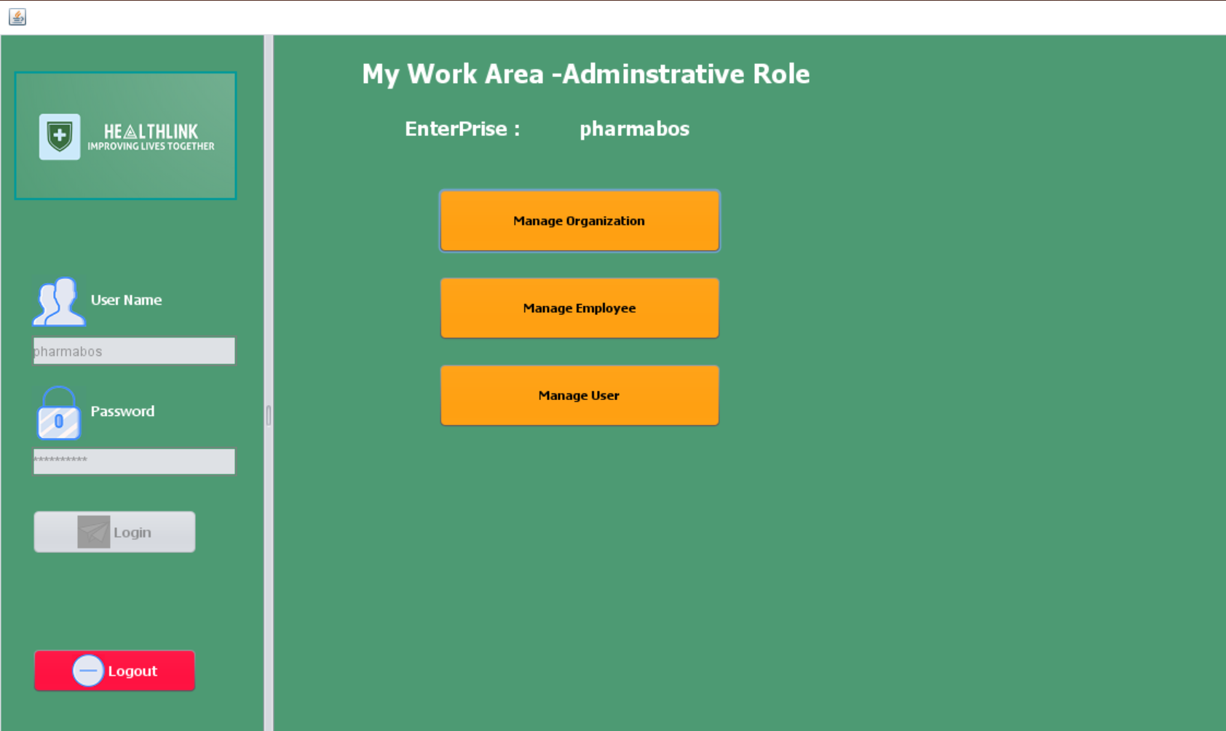
Application User Interface – Pharma Admin Login Page

Slide 22
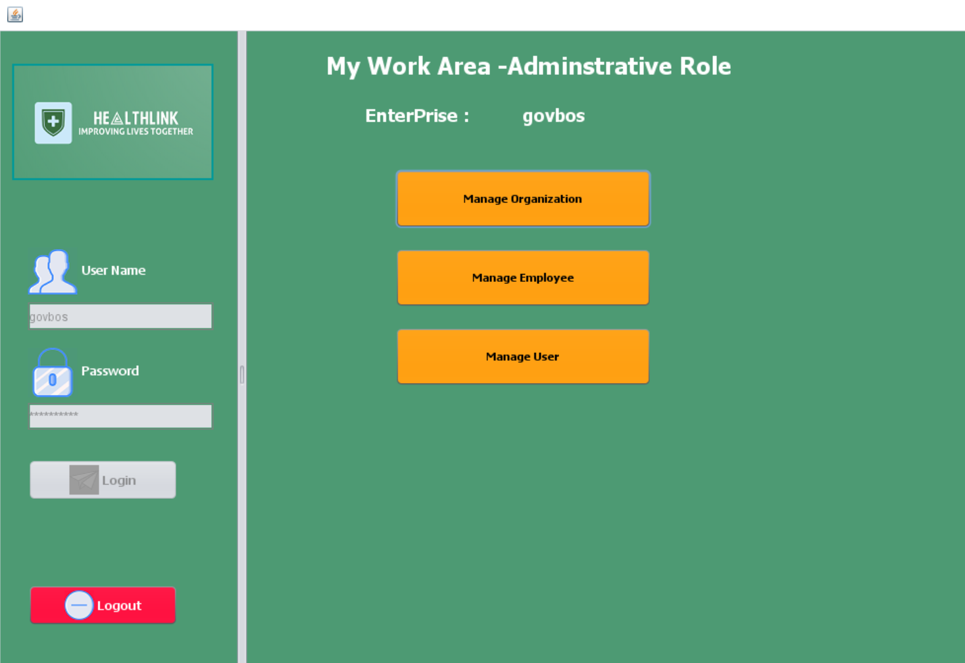
Application User Interface – Government Admin Login Page

Slide 23










Advanced Features - Unique Selling Point
Real- Time Google Maps Accessibility
Live Webcam Image Capture
Real- time Email Notification
Real-Time SMS Notification
Print & Download Documents
Real-Time Analytics
File Attachments

Slide 24
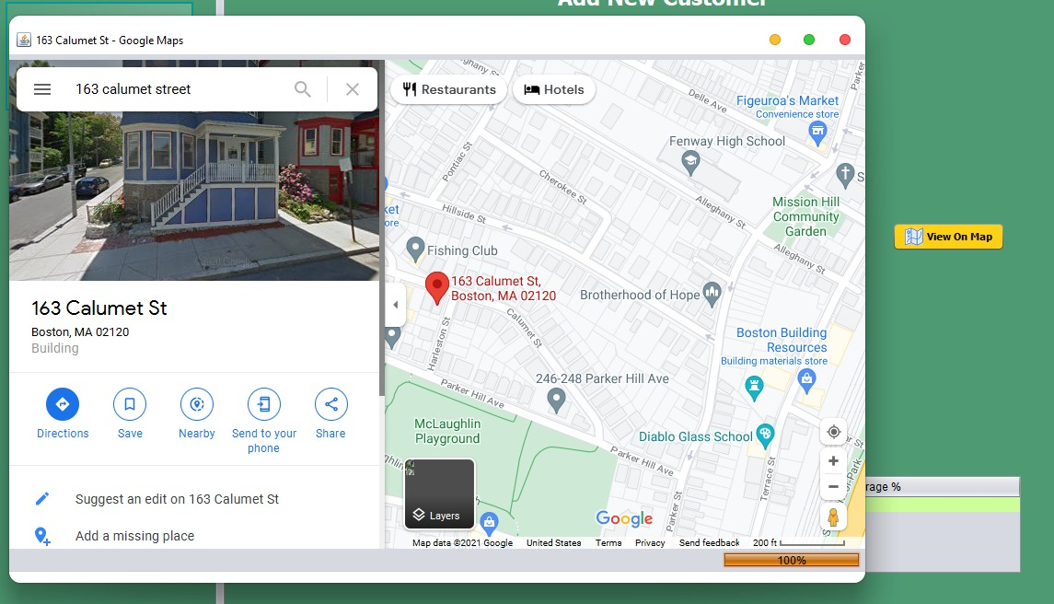
Real Time Google Maps Accessibility

Slide 25
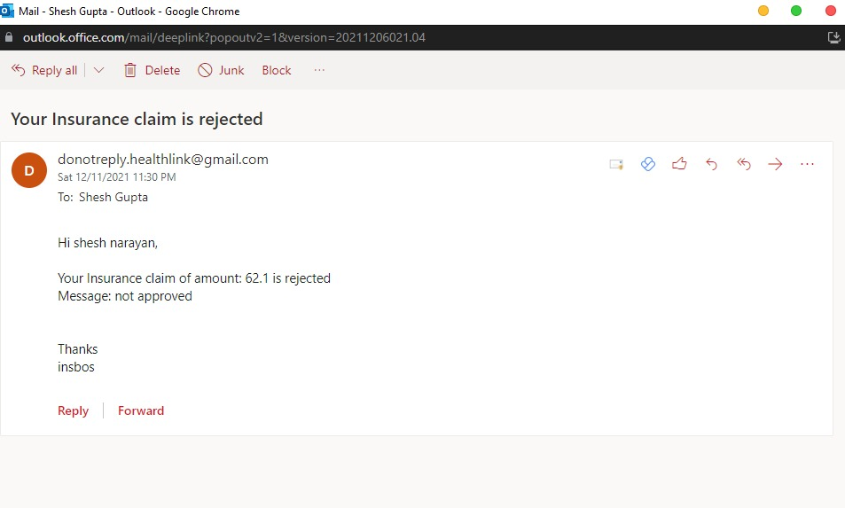
Real-Time Email Notification

Slide 26
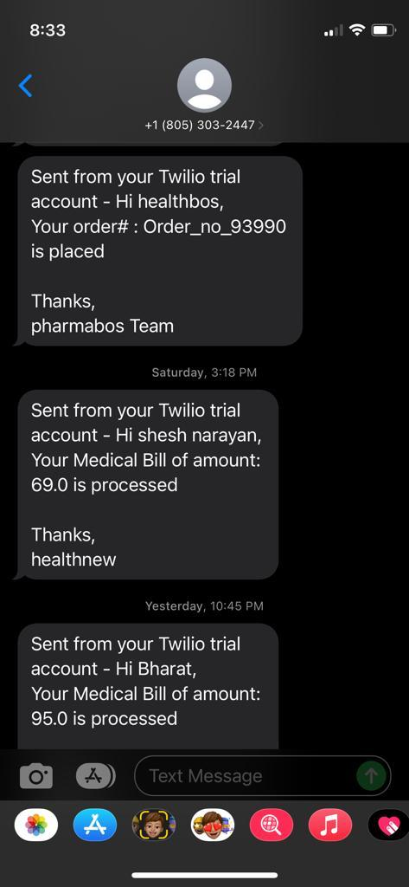
Real-Time SMS Notification

Slide 27
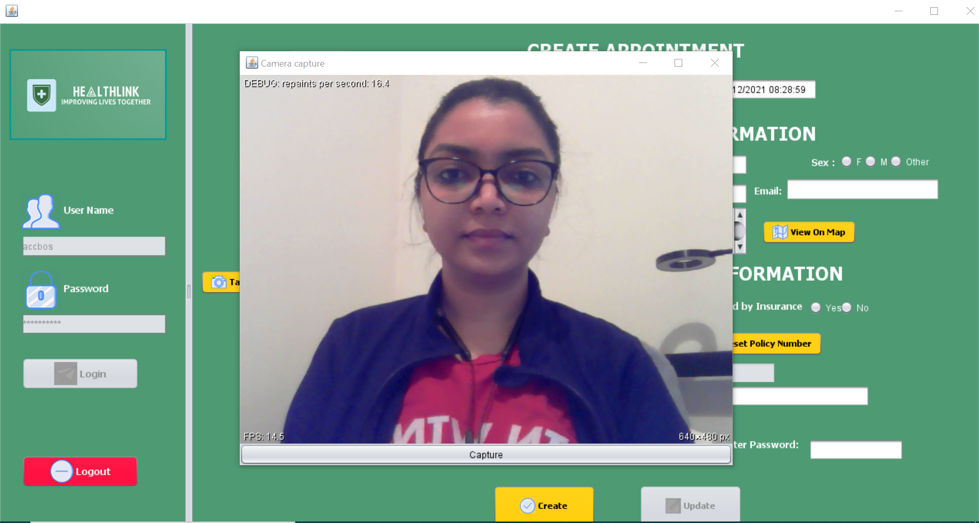
Live Web-cam Image Capture

Slide 28
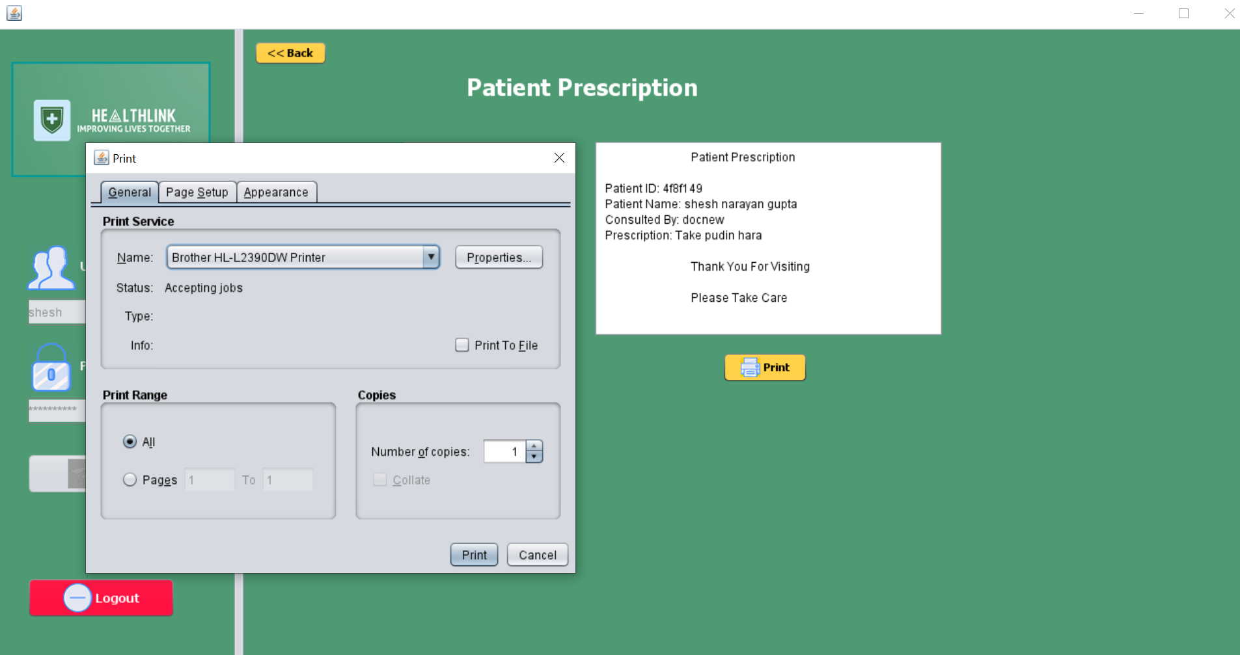
Print & Download Documents

Slide 29
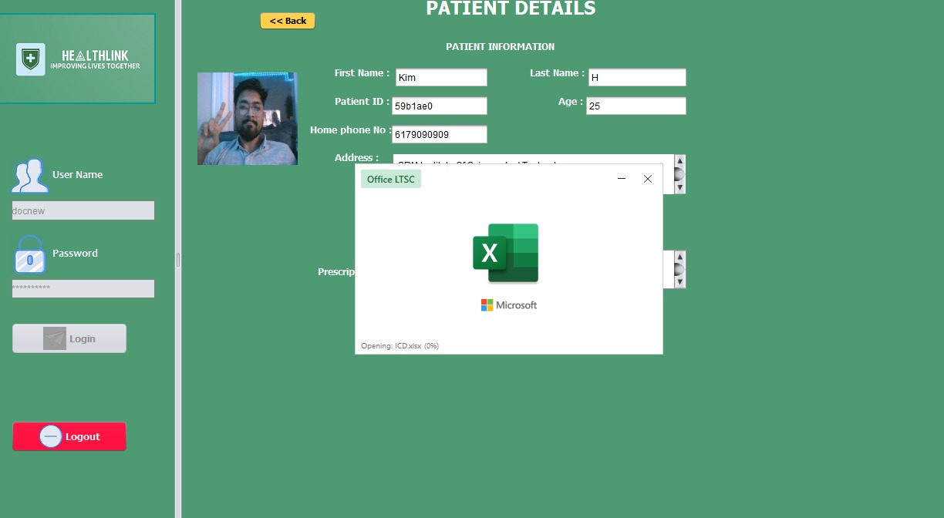
File Attachments

Slide 30
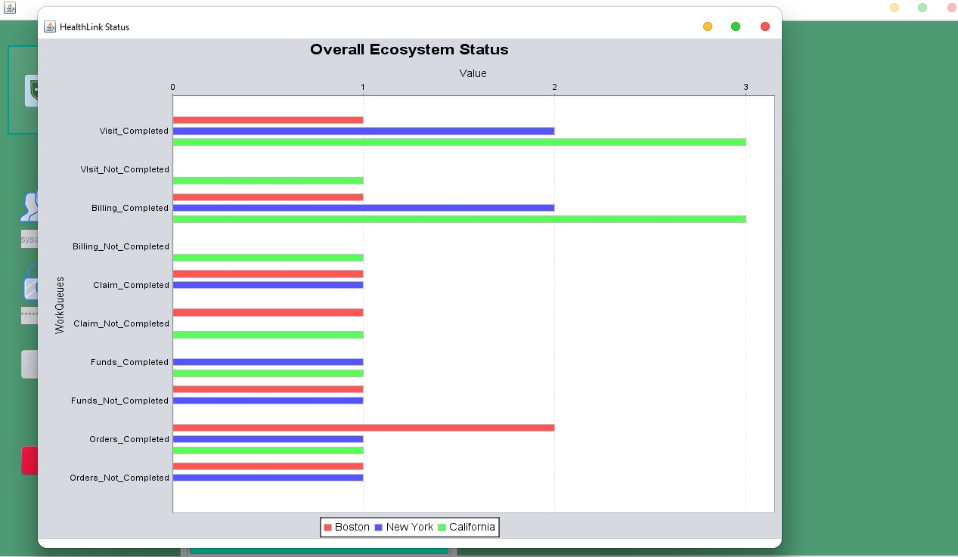
Data Visualisations – Overall Ecosystem Status

Slide 31
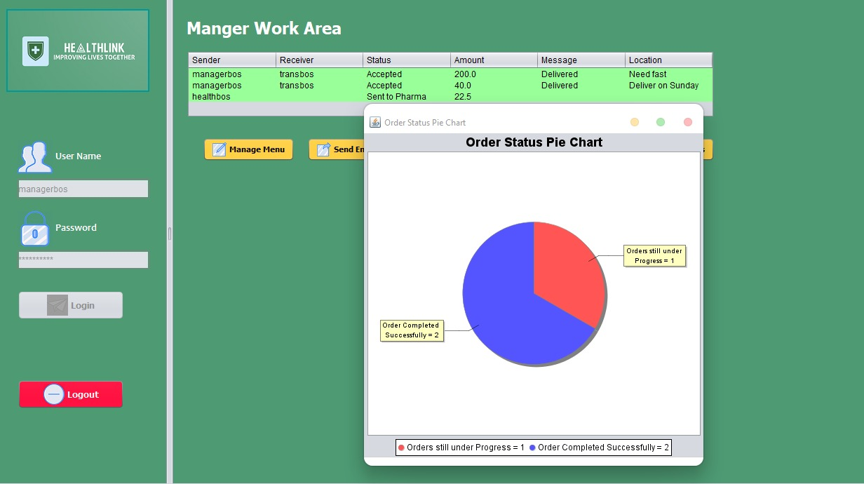
Data Visualisations

Slide 32
Thank you
Do you have any questions?

